Slide 1



Protein Folding
Uniform Random Sampling and Optimal Folding Point Identification using the HP-Model and Randomly Generated Amino Acids

Slide 2
Protein Folding 101

Slide 3
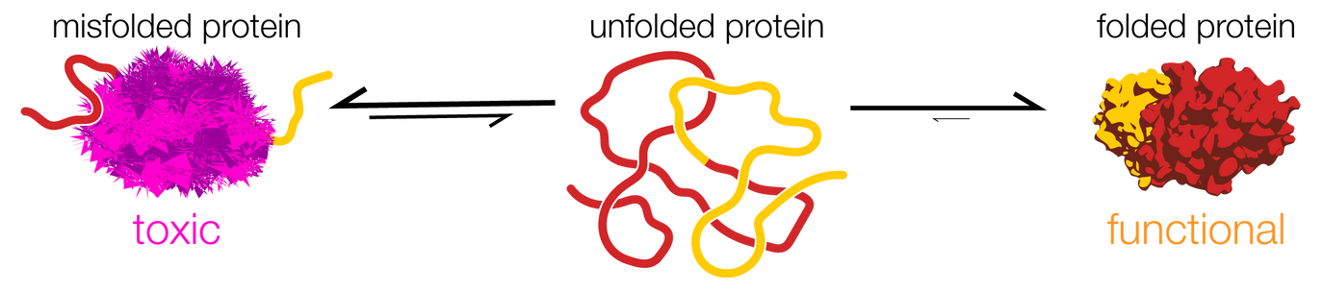
Why do proteins fold?
Folding proteins refers to the process of proteins taking on their functional structure from their linear sequence of amino acids. This process is essential because the function of a protein is directly linked to its structure.
Misfolded protein
Unfolded protein
Folded protein
Toxic
Functional
No function
01
Notes:
Folding proteins refers to the process of proteins taking on their functional structure from their linear sequence of amino acids.
This process is essential because the function of a protein is directly linked to its structure.

Slide 4






Why should we fold proteins?
Folding proteins refers to the process of proteins taking on their functional structure from their linear sequence of amino acids. This process is essential because the function of a protein is directly linked to its structure.
Misfolded protein
Folded protein
Toxic
Functional
Diseases
Functionalities
Alzheimer’s
Parkinson’s
Diabetes
Muscle contraction
Woud healing
Immune
system
02

Slide 5
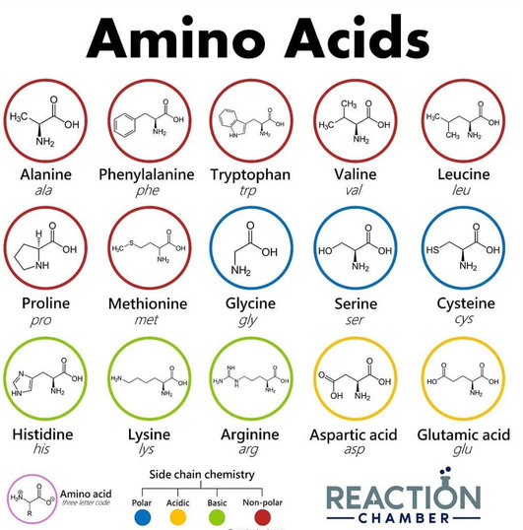




Protein and aminos
A protein consists of amino acids. The average protein consists of 200-300 amino acids, with insulin being a relatively small protein.
20 different amino acids
Insulin - 51 amino acids
Chain A - 21 amino acids
GIVEQCCTSICSLYQLENYC
Chain B - 30 amino acids
FVNQHLCGSHLVEALYLVCGERGFFYTPKT
Average Protein = 2.000 amino acids
CGSHLVEALYLVCGERGFFYTPKTFVNQHLCGSHLVEALYLVCGERGFFYTPKTCGSHLVEALYLVCGERGFFYTPKTCGSHLVEALYLVCGERGFFYTPKTFVNQHL
03
Notes:
A protein consists of amino acids. The average protein consists of 200-300 amino acids, with insulin being a relatively small protein.

Slide 6
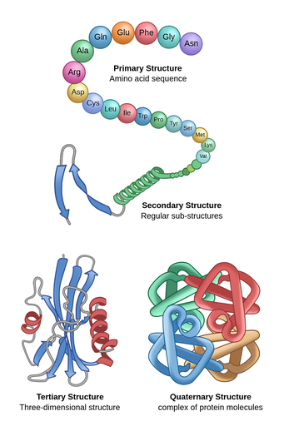
Protein Structure
Proteins can be described in terms of four levels of structure: primary, secondary, tertiary, and quaternary. These levels of structure are referred to as 1D, 2D, 3D, and 4D, respectively.
Primary Structure (1D)
Secondary Structure (2D)
Description: Primary structure refers to the linear sequence of amino acids that make up the protein.
Importance: Sequence determines the protein’s type and function. Even a small change in the sequence can significantly affect the protein’s properties.
Description: Folding amino acid chain into regular, repeating structures stabilized by hydrogen bonds.
Importance: Structures provide a level of organization and stability within the protein.
Tertiary Structure (3D)
Quaternary Structure (4D)
Description: Folding and arrangement of the secondary structural elements, stabilized by various types of bonds and interactions.
Importance: Vital for the protein's function, as it positions the protein’s in specific orientations that are necessary for activity.
Description: Arrangement of multiple subunits into a functional protein complex. Not all proteins have a quaternary structure.
Importance: Mediates the interaction of proteins with other molecules, including other proteins
04
Notes:
Proteins can be described in terms of four levels of structure: primary, secondary, tertiary, and quaternary. These levels of structure are referred to as 1D, 2D, 3D, and 4D, respectively.

Slide 7

05

Slide 8

AlphaFold
AlphaFold is used to predict the tertiary structure (3D) of proteins. It takes the primary structure (1D) as input and predicts how those amino acids will fold into the final 3D structure.
Primary Structure (1D)
Secondary Structure (2D)
Tertiary Structure (3D)
Quaternary Structure (4D)
Description: Primary structure refers to the linear sequence of amino acids that make up the protein.
Importance: Sequence determines the protein’s type and function. Even a small change in the sequence can significantly affect the protein’s properties.
Description: Folding amino acid chain into regular, repeating structures stabilized by hydrogen bonds.
Importance: Structures provide a level of organization and stability within the protein.
Description: Folding and arrangement of the secondary structural elements, stabilized by various types of bonds and interactions.
Importance: Vital for the protein's function, as it positions the protein’s in specific orientations that are necessary for activity.
Description: Arrangement of multiple subunits into a functional protein complex. Not all proteins have a quaternary structure.
Importance: Mediates the interaction of proteins with other molecules, including other proteins
Input
Substructure
Output
06
Deep learning
Deep learning
Notes:
AlphaFold is used to predict the tertiary structure (3D) of proteins. It takes the primary structure (1D) as input and predicts how those amino acids will fold into the final 3D structure.

Slide 9
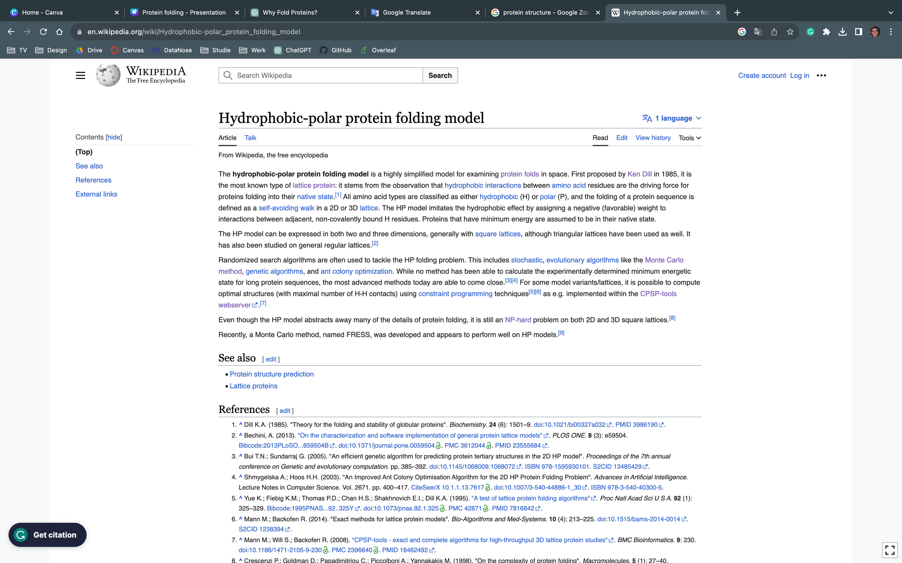

07

Slide 10
HP-model
The Hydrophobic-polar (HP) model developed by Ken Dill is used in optimization to predict the most stable conformation of a protein.
Primary Structure (1D)
Secondary Structure (2D)
Tertiary Structure (3D)
Quaternary Structure (4D)
Description: Primary structure refers to the linear sequence of amino acids that make up the protein.
Importance: Sequence determines the protein’s type and function. Even a small change in the sequence can significantly affect the protein’s properties.
Description: Folding amino acid chain into regular, repeating structures stabilized by hydrogen bonds.
Importance: Structures provide a level of organization and stability within the protein.
Description: Folding and arrangement of the secondary structural elements, stabilized by various types of bonds and interactions.
Importance: Vital for the protein's function, as it positions the protein’s active sites and other functional domains in specific orientations that are necessary for activity.
Description: Arrangement of multiple subunits into a functional protein complex. Not all proteins have a quaternary structure.
Importance: Mediates the interaction of proteins with other molecules, including other proteins
Input
Output
08
Optimization Algorithms
Notes:
The Hydrophobic-polar (HP) model developed by Ken Dill is used in optimization to predict the most stable conformation of a protein. It uses the 1d structure in combination with optimization algorithm to predicrt the 2d structure

Slide 11
HP-model
The Hydrophobic-polar (HP) model developed by Ken Dill is used in optimization to predict the most stable conformation of a protein.
20 to 2 acids
Insulin - 51 amino acids
Insulin - 51 amino acids
Chain A - 21 amino acids
GIVEQCCTSICSLYQLENYC
Chain A - 21 amino acids
HPPPHHHPPPHHHPPPHP
H
P
Chain B - 30 amino acids
FVNQHLCGSHLVEALYLVCGERGFFYTPKT
Chain B - 30 amino acids
HPHHPPPHPPPPHHPPPHHHPPPHHHPP
Simplification
09

Slide 12

HP-model
The Hydrophobic-polar (HP) model developed by Ken Dill is often used in optimization to predict the most stable conformation of a protein.
1D representation
2D representation
Chain A - 21 amino acids
HPPPHHHPPPHHHPPPHP
Chain B - 30 amino acids
HPHHPPPHPPPPHHPPPHHHPPPHHHPP
1D to 2D
10

Slide 13

HP-model
In the context of the HP model, the energy is typically calculated based on the number of adjacent hydrophobic acids in the folded state of the protein. These are called H-bonds.
Energy calculation -?
Energy calculation -1
Energy calculation -3
11

Slide 14
Scope 1
12

Slide 15
Uniform Random Samling
“How can the uniform randomness in the initial populations of metaheuristic algorithms, such as genetic algorithms, hill climbing, or simulated annealing, be ensured to enhance the accuracy and efficiency of protein folding, and what is the impact of different sampling techniques on the quality and diversity of solutions in the context of the HP-protein folding problem?"
13
Notes:
“How can the uniform randomness in the initial populations of metaheuristic algorithms, such as genetic algorithms, hill climbing, or simulated annealing, be ensured to enhance the accuracy and efficiency of protein folding, and what is the impact of different sampling techniques on the quality and diversity of solutions in the context of the HP-protein folding problem?"

Slide 16
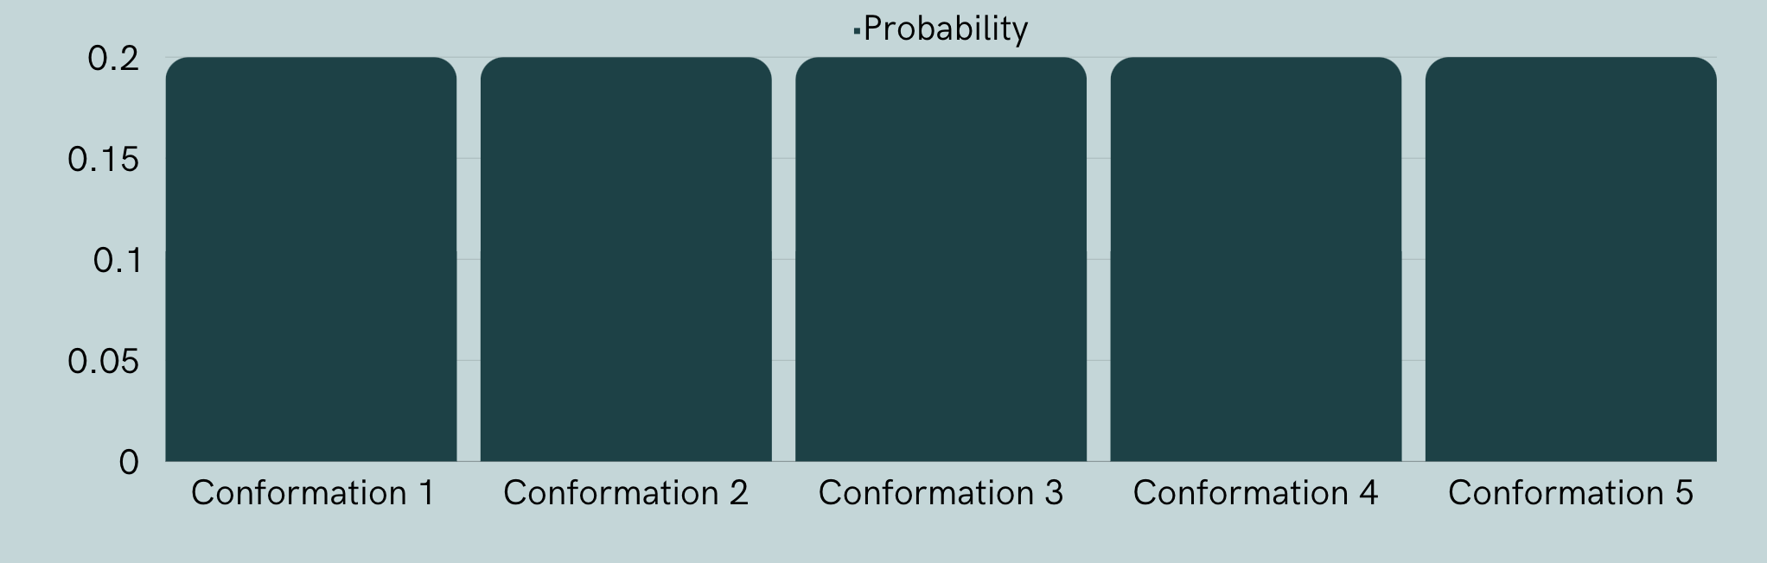
Uniform Random Samling
A uniform random sample refers to selecting a random folded protein conformation from a larger population of folded protein conformations in a way that configuration has an equal probability of being chosen.
14

Slide 17
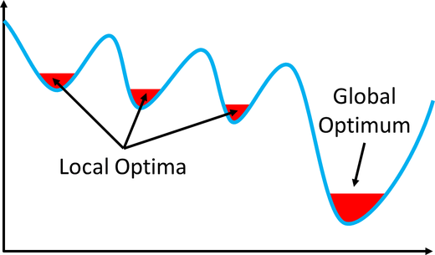
Uniform Random Samling
Why do we want a uniform﻿ random sample?
Limited Diversity
Issue: Non-uniform random sampling leads to a population that is not diverse. A lack of diversity means fewer unique solutions are being explored.
Result: The algorithm may quickly converge to a local optimum because it doesn’t have the diversity needed to explore other potentially superior solutions.
Premature Convergence
Issue: When the initial population isn’t uniformly and randomly sampled, there’s a risk of premature convergence, where the algorithm settles on a suboptimal solution too quickly.
Result: It doesn’t explore enough of the solution space to find the global optimum.
15
Notes:
1. Limited Diversity:
Issue: Non-uniform random sampling leads to a population that is not diverse. A lack of diversity means fewer unique solutions are being explored.
Result: The algorithm may quickly converge to a local optimum because it doesn’t have the diversity needed to explore other potentially superior solutions.
2. Premature Convergence:
Issue: When the initial population isn’t uniformly and randomly sampled, there’s a risk of premature convergence, where the algorithm settles on a suboptimal solution too quickly.
Result: It doesn’t explore enough of the solution space to find the global optimum.
3. Overfitting:
Issue: Non-uniform sampling can lead to overfitting, where the solutions are overly tailored to specific parts of the data and do not generalize well.
Result: The solutions work well for the sampled data but are not optimal when applied more broadly.
4. Search Space Exploration:
Issue: Uniform random sampling ensures a broad and diverse exploration of the search space. Without it, the EA can become too focused on certain regions of the search space.
Result: Misses out on exploring areas that might contain the global optimum.

Slide 18
Experiment
16

Slide 19



Experiment
Three different sampling techniques for random protein sampling.
Sampling with collisions*
Counts the number of collisions
Sampling with break
Break when no adjacent locations
Sampling with backtracking
Backtrack when no adjacent locations
*Work by Jansen et al., (2023)
17

Slide 20
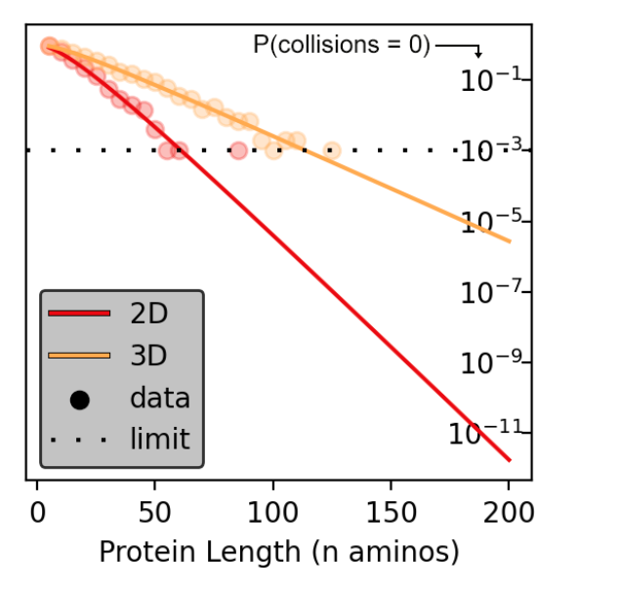
Experiment
Collision sampling on a 2D and 3D grid. Randomly folded 1000 samples for protein for lengths
n ∈ {5, 10, 15...195, 200}.
Sampling with collisions*
Counts the number of collisions
number of collisions increase as number of amino acids increases
The chance of randomly sampling a zero-collision conformation drops exponentially in n. Figure from Jansen et al., (2023).
18

Slide 21
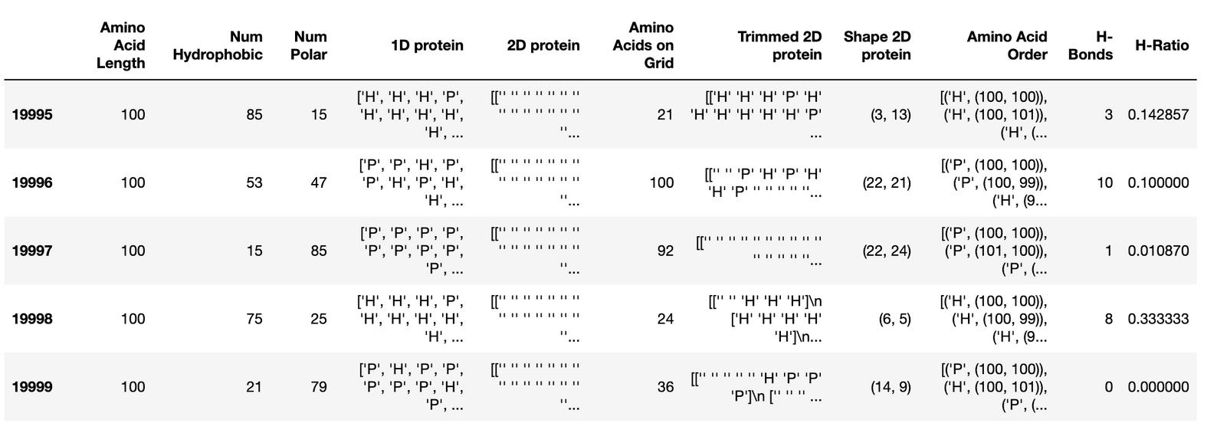
Experiment
We generate 1000 randomly folded proteins for lengths n ∈ {5, 10, 15...195, 100}.
Programmed to scale up the experiment for both amino acid length and sample sizes.
Sampling with break
Break when no adjacent locations
19

Slide 22
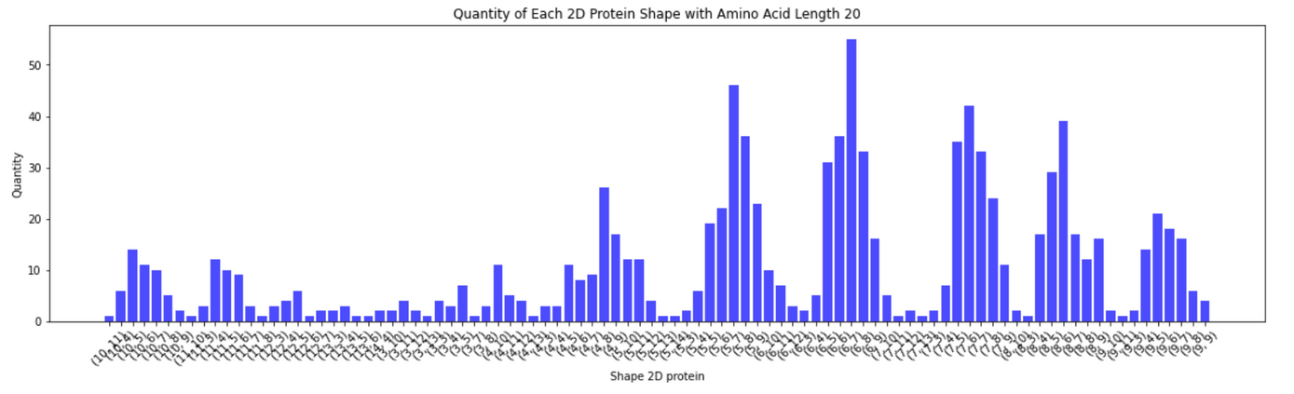
Experiment
We generate 1000 samples for protein for lengths n ∈ {5, 10, 15...195, 100}. Programmed to scale up experiment for both amino acid length and sample sizes.
Sampling with break
Break when no adjacent locations
The shape of a protein seems the be normally distributed around squared conformations
e.g. 7x7, 6x6.
20

Slide 23
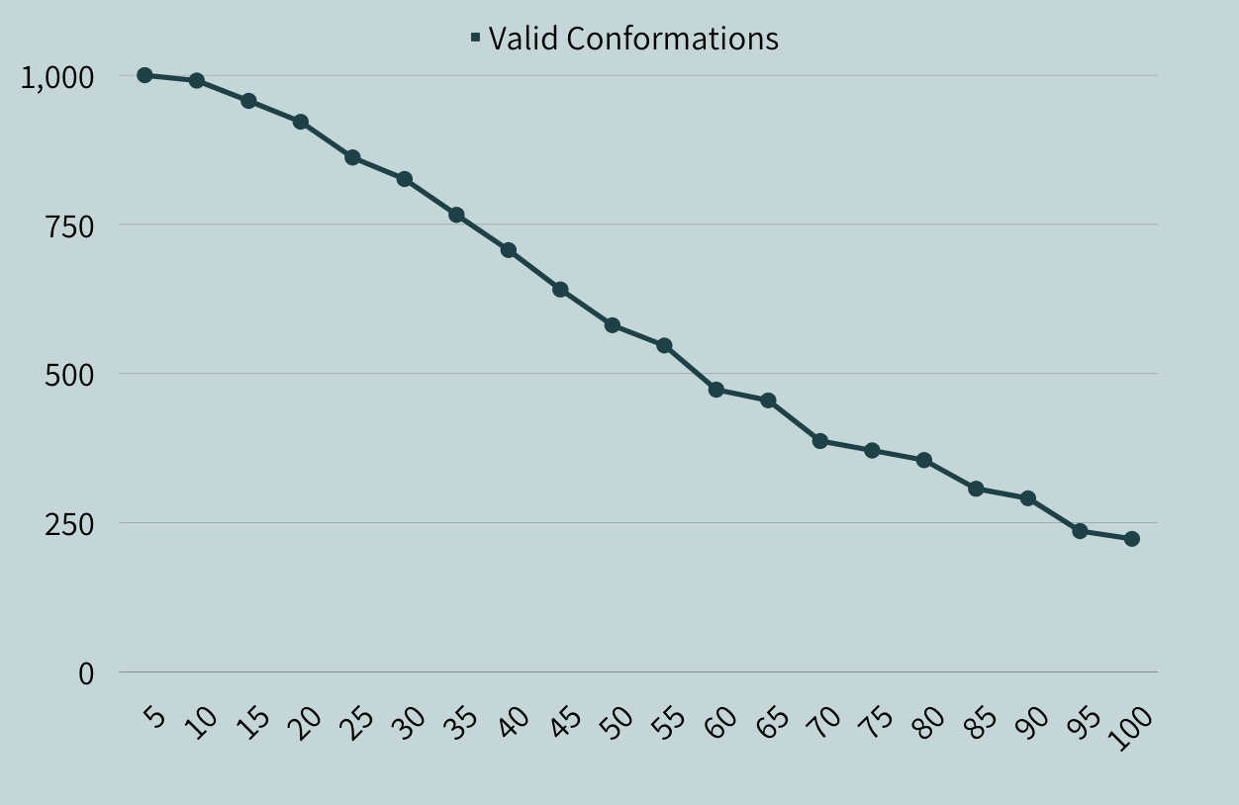
Experiment
We generate 1000 samples for protein for lengths n ∈ {5, 10, 15...195, 100}. Programmed to scale up experiment for both amino acid length and sample sizes.
Sampling with break
Break when no adjacent locations
number of breaks increase as number of amino acids increases
21

Slide 24
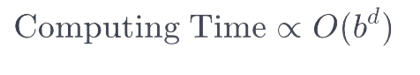
Experiment
b: Branching factor - the average number of child nodes in the search tree (4).
d: Depth of the search tree - amino acids to be placed on grid ()
WIP!
Generate 100 standard backtracking samples for protein for lengths n ∈ {5, 10, 15, 20}.
Scale up sample size
Scale up protein length
Generate 100 randomized backtracking samples for protein for lengths n ∈ {5, 10, 15, 20}.
Step 2: Scale up sample size
Step 3: Scale up protein length
Sampling with backtracking
Backtrack when no adjacent locations
22

Slide 25
Scope 2
23

Slide 26

Optimal Folding Point Identifi﻿cation
"In the context of employing uniform random sampling in metaheuristic algorithms for protein folding simulations, how does the selection of the starting conformation influence the computational efficiency and temporal dynamics of reaching a global optimum of minimum energy, and what role does the initiation point play in the exploration-exploitation trade-off, particularly within the framework of the HP-protein folding problem?"
Probably a bit too much for 18 ECTS, but very interesting.
24

Slide 27
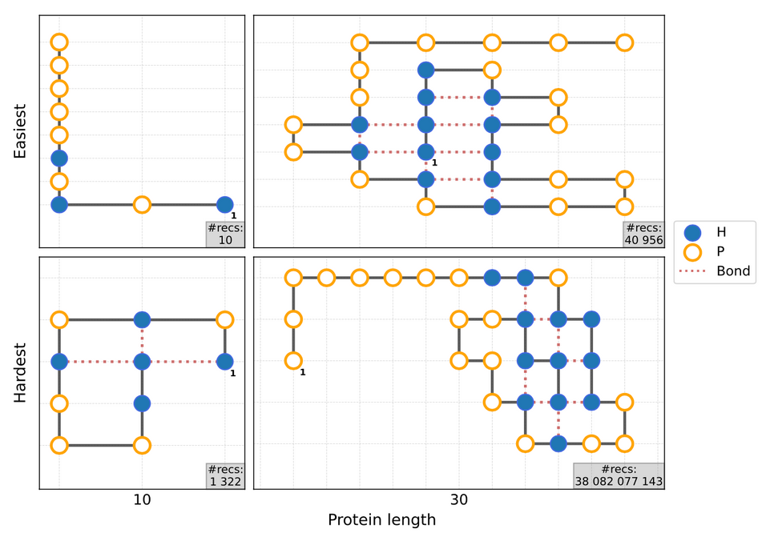
Optimal Folding Point Identifi﻿cation
Given a uniform random sample, does the point at which we start folding have a significant influence on the time at which we can reach a global optimum with minimum energy?
Minimum energy conformations for the easiest and hardest problem instances of lengths 10 and 30. Figure from van Eck (2023).
25

Slide 28
Thanks!
26

